Slide 1

Assisting doctors to save lives with Alfresco & Xedoc
Victor Fariña
CEO @QueresTic

Slide 2

Presentation

Slide 3


Team
…
…
20 people

Slide 4







Slide 5

What do we expect in 2017?
> 10 years
> 10 years

Slide 6

What do we expect in 2017?
> 15 years

Slide 7
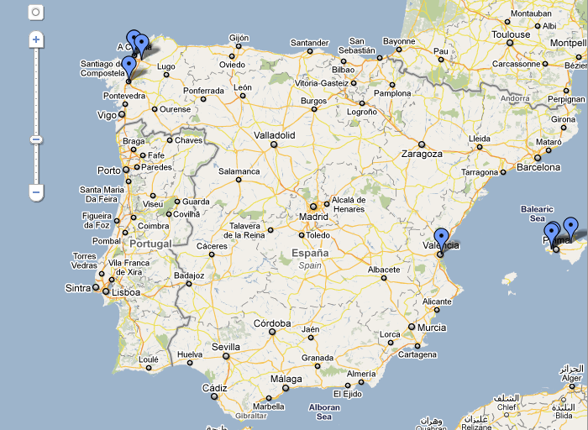

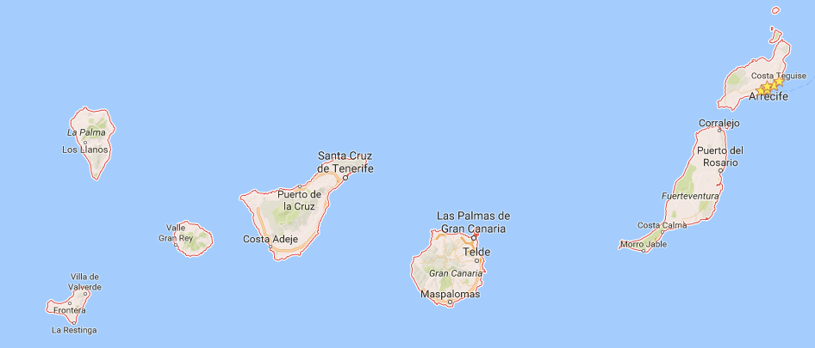
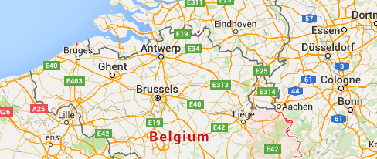
What do we expect in 2017?

Slide 8
Alfresco Partners since 2006
Half of the Company are certified

Slide 9
Main Pain

Slide 10
Peter

Slide 11
What do we expect in 2017?
8 years of tests

Slide 12
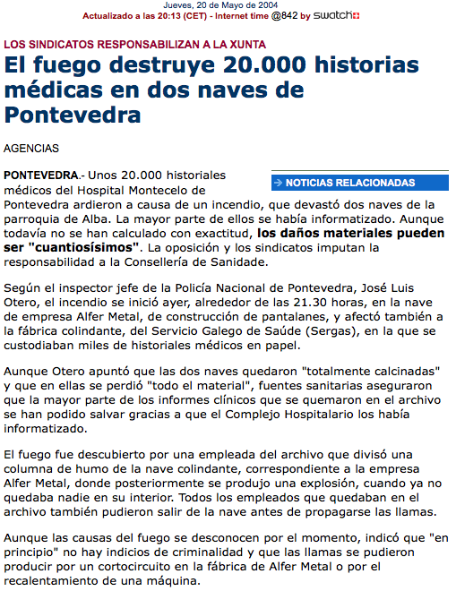
What do we expect in 2017?
2004
20k patient documents

Slide 13
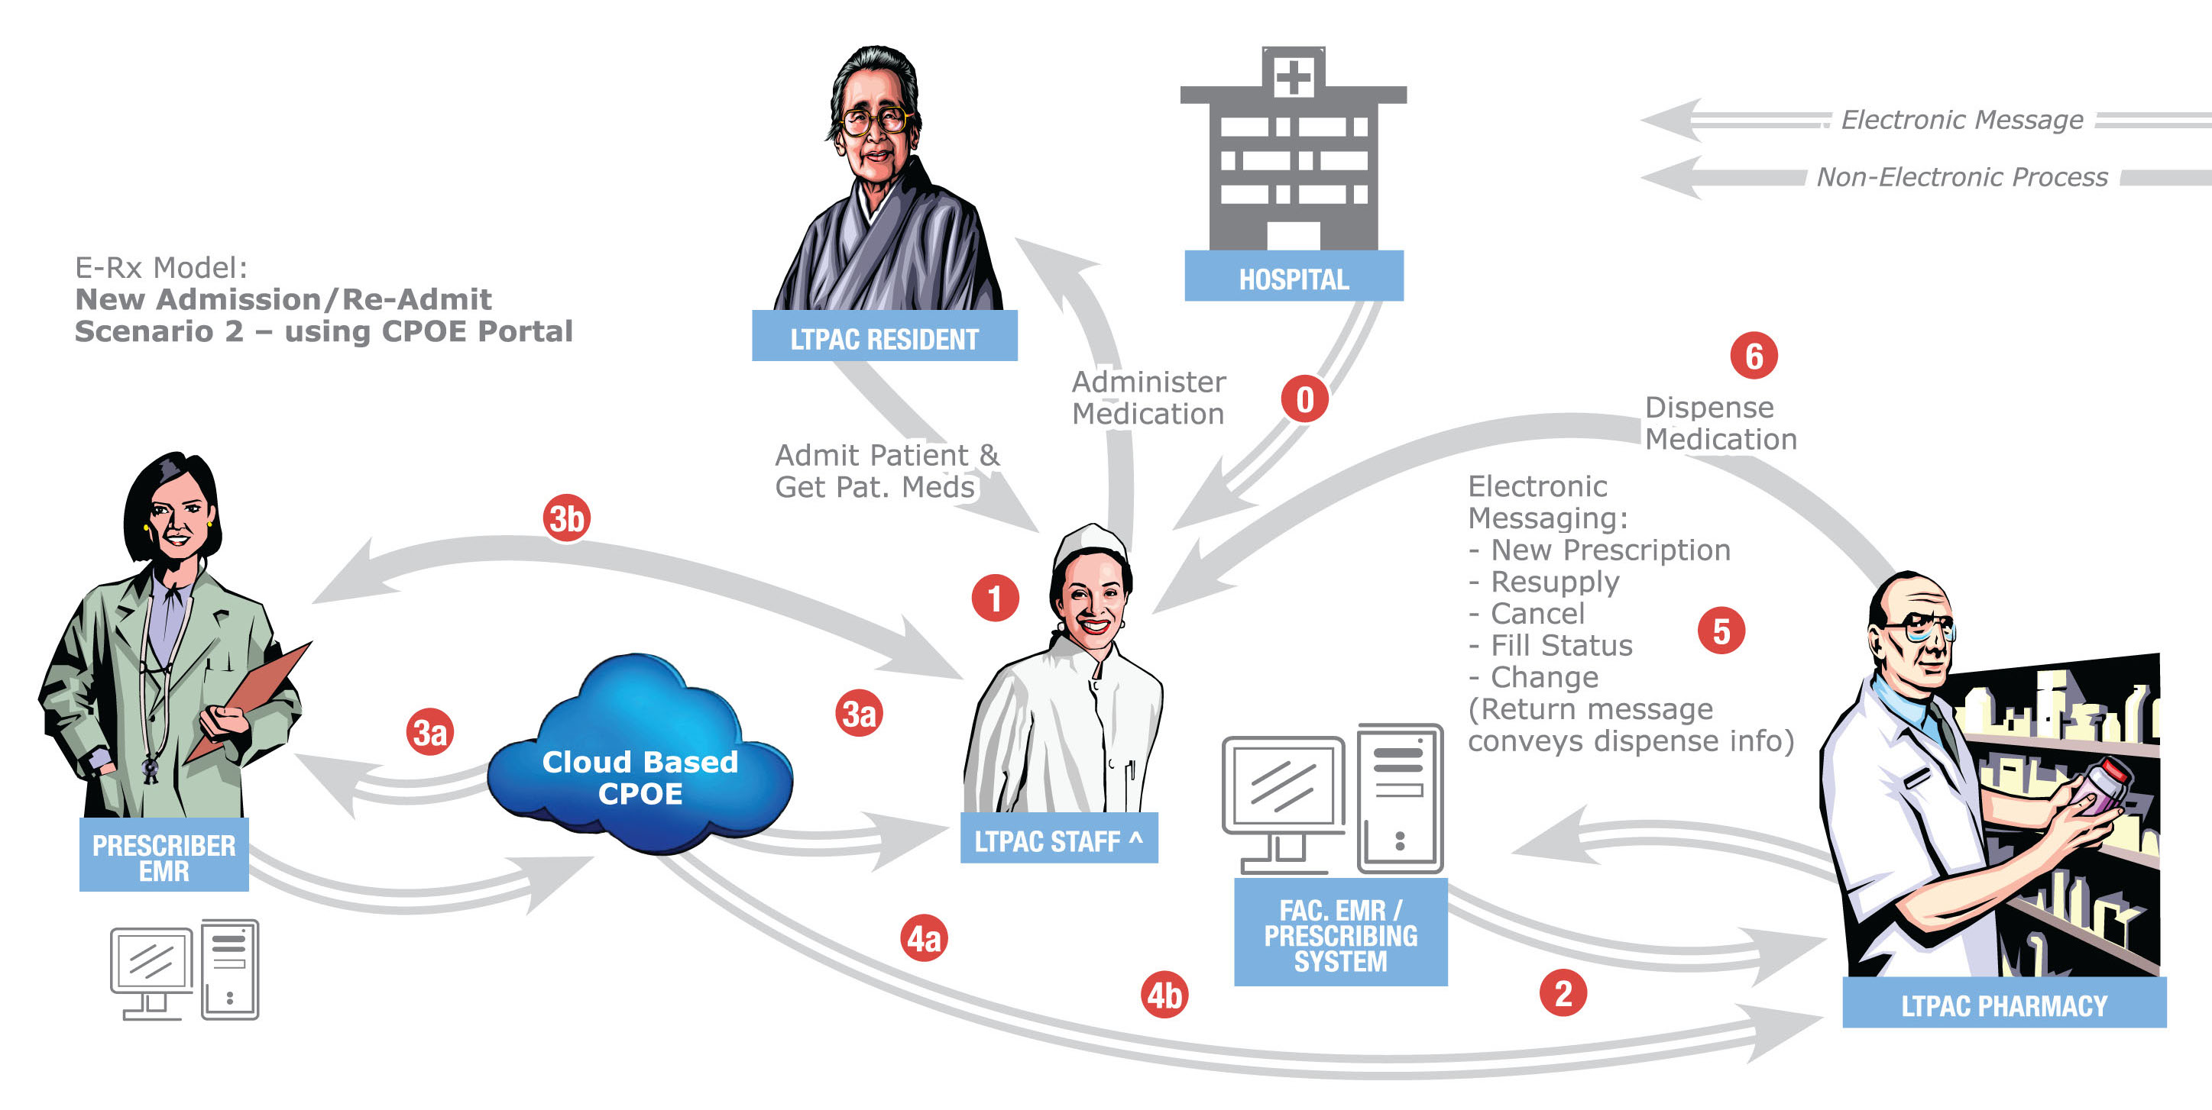
Practicioner access
Access from another hospital, ER, etc …

Slide 14
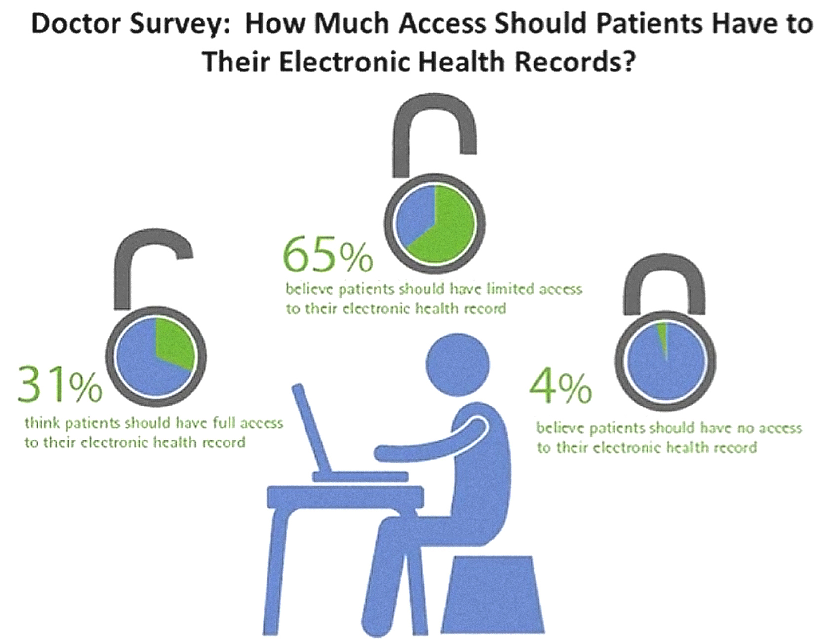
Patient access

Slide 15
Patient access

Slide 16
Remote access to our EHR

Slide 17
EHR

Slide 18
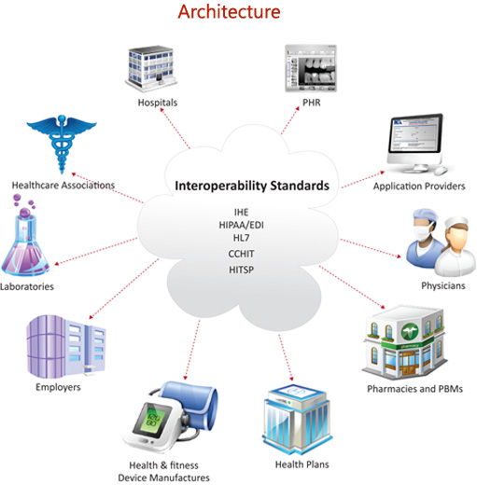

Slide 19
Approach

Slide 20
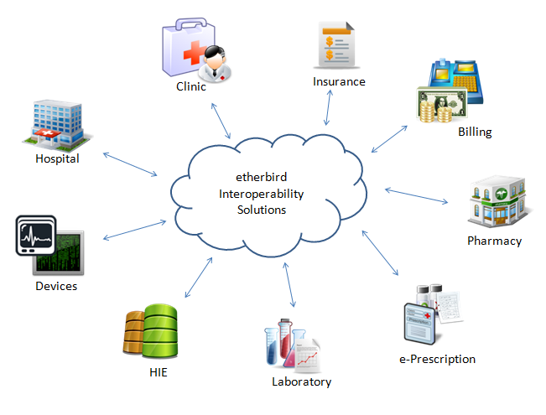

Slide 21
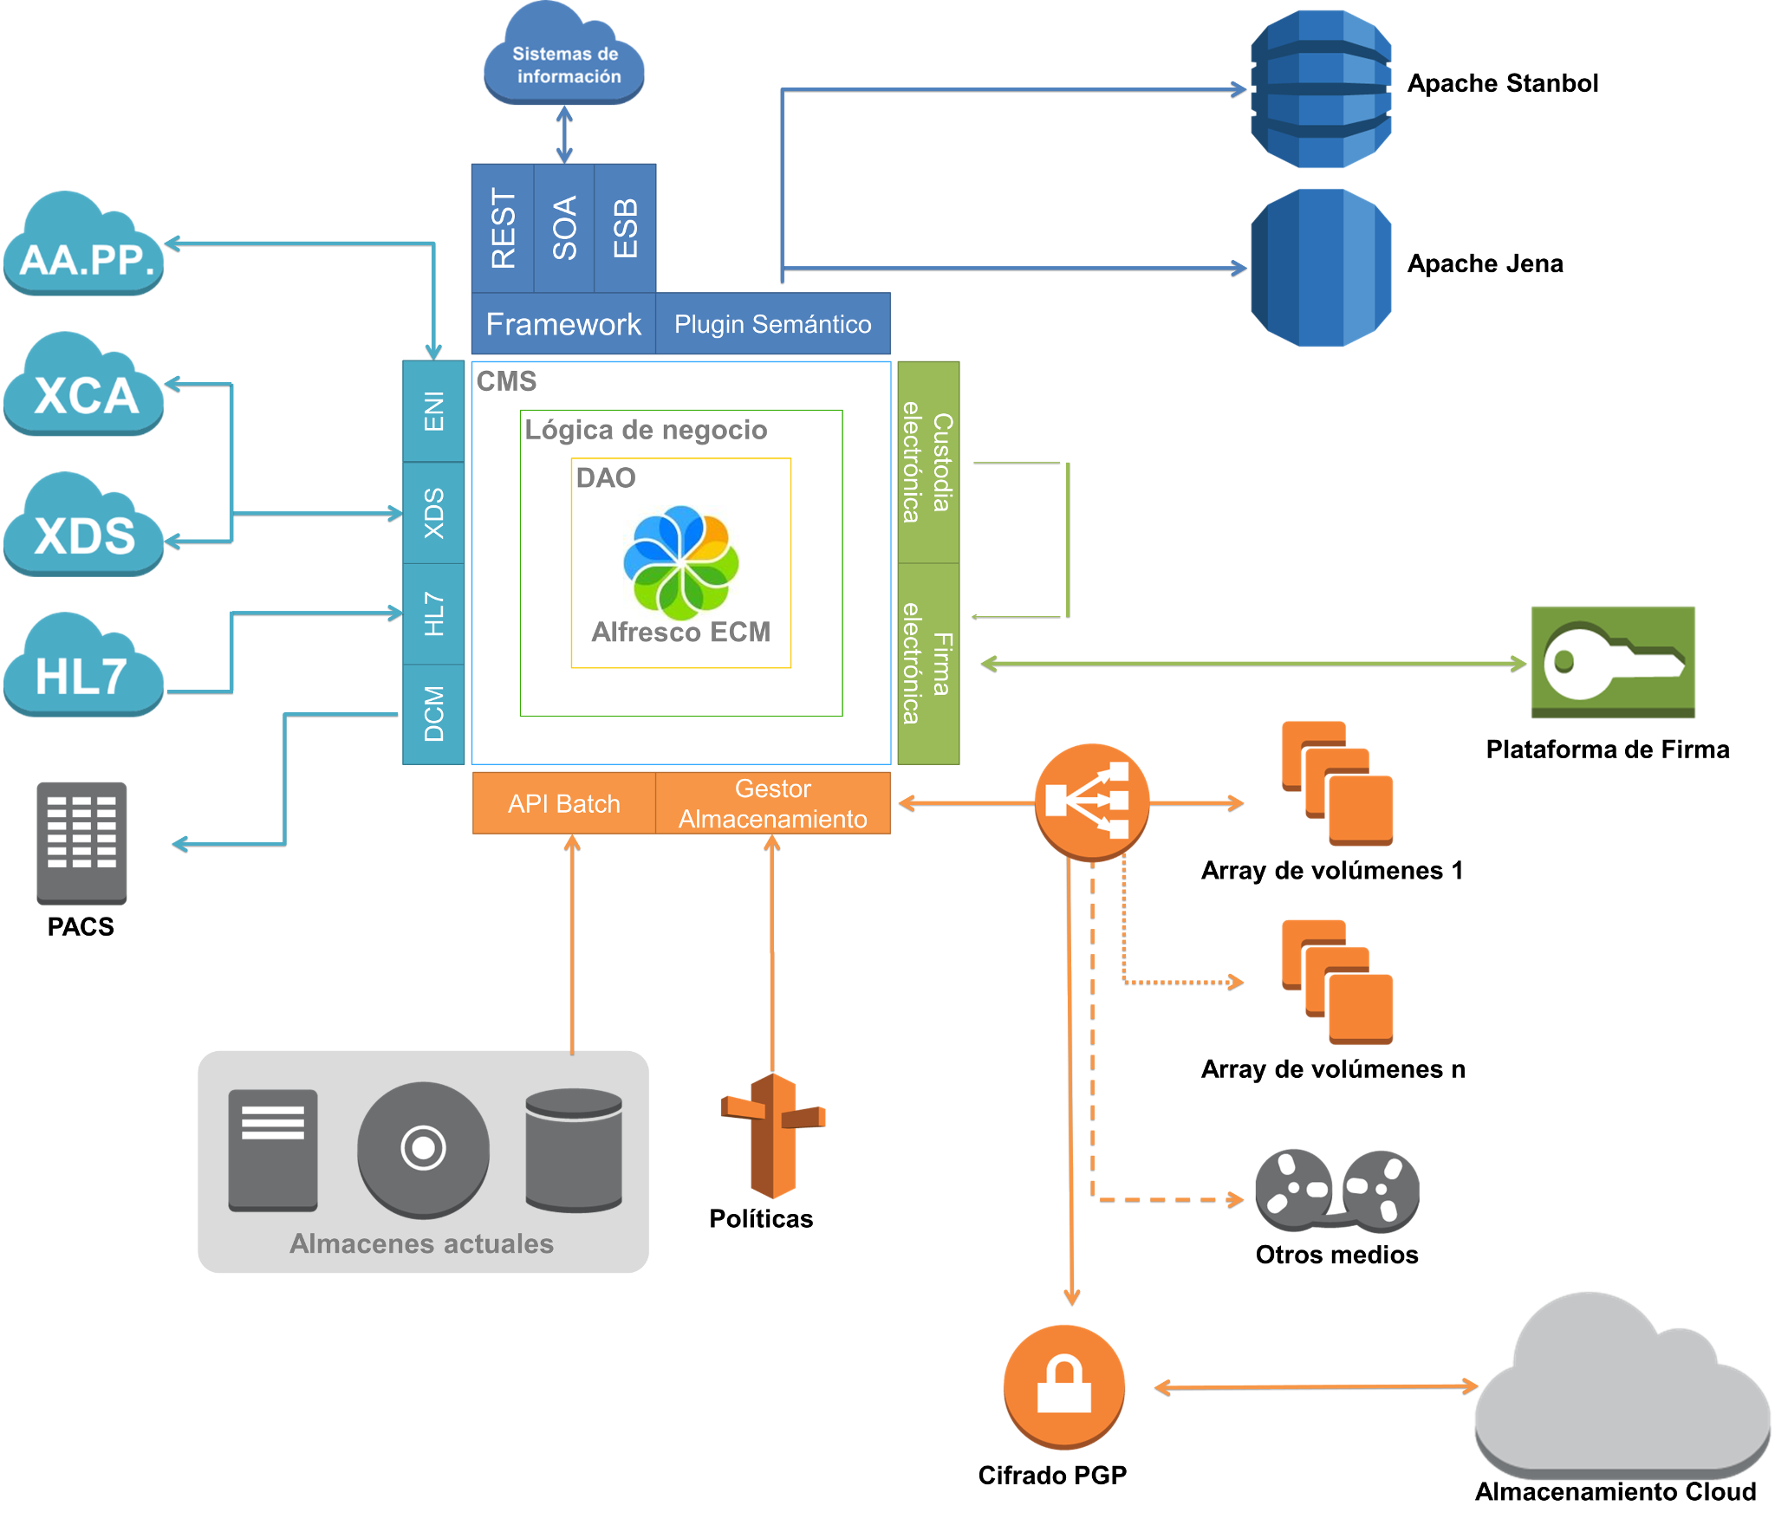
Big picture

Slide 22
Big picture
SOA
ILM
Custody
Semantic
Migration

Slide 23
Interoperability Hub

Slide 24
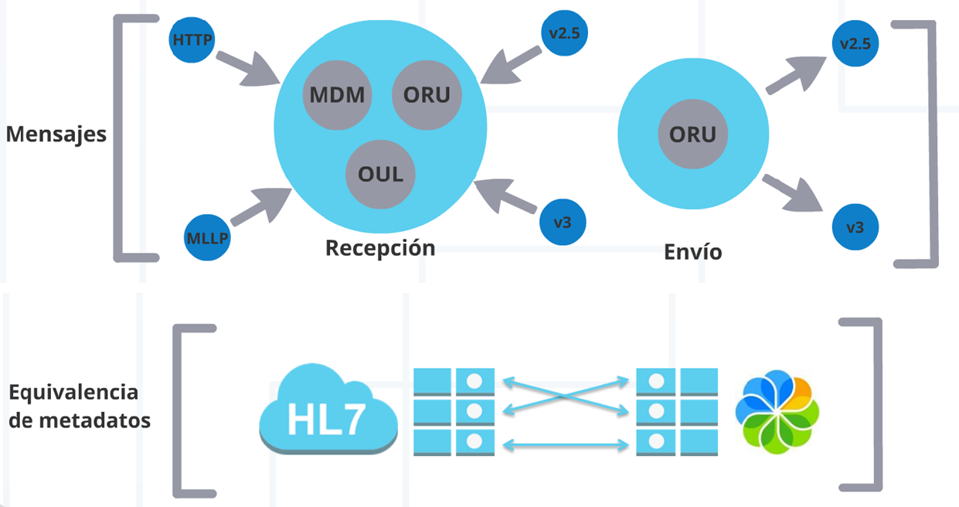
Interoperability Hub

Slide 25
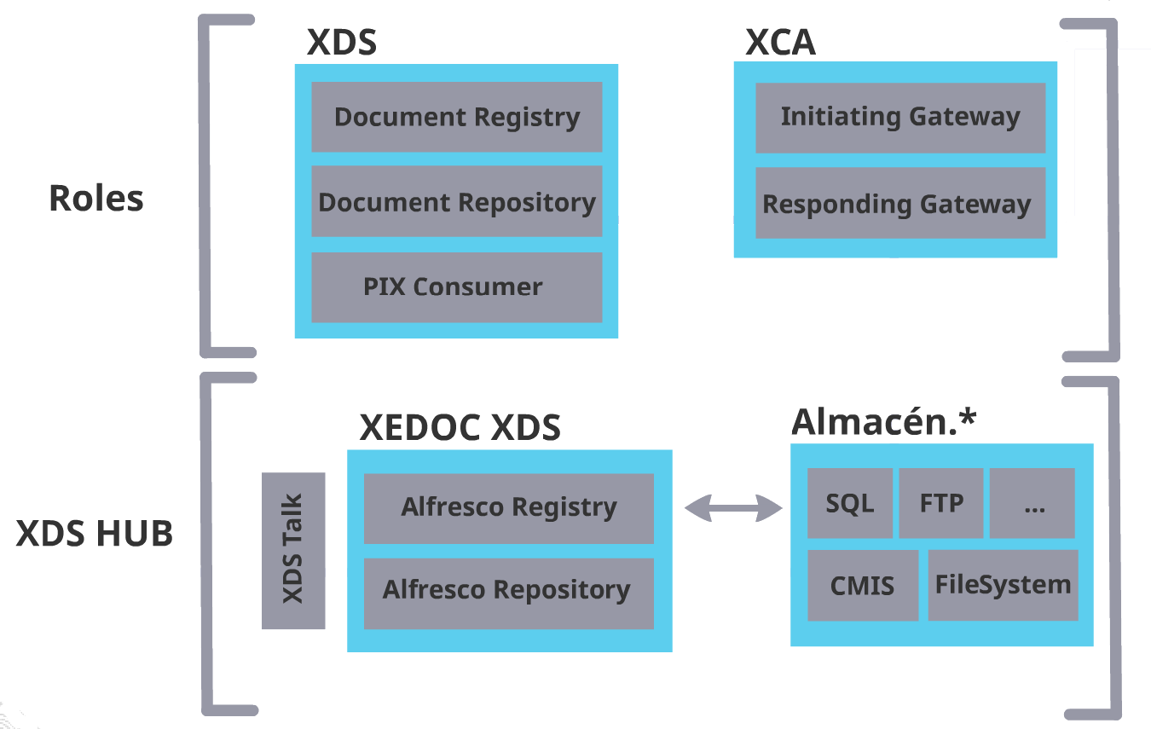
Interoperability Hub

Slide 26
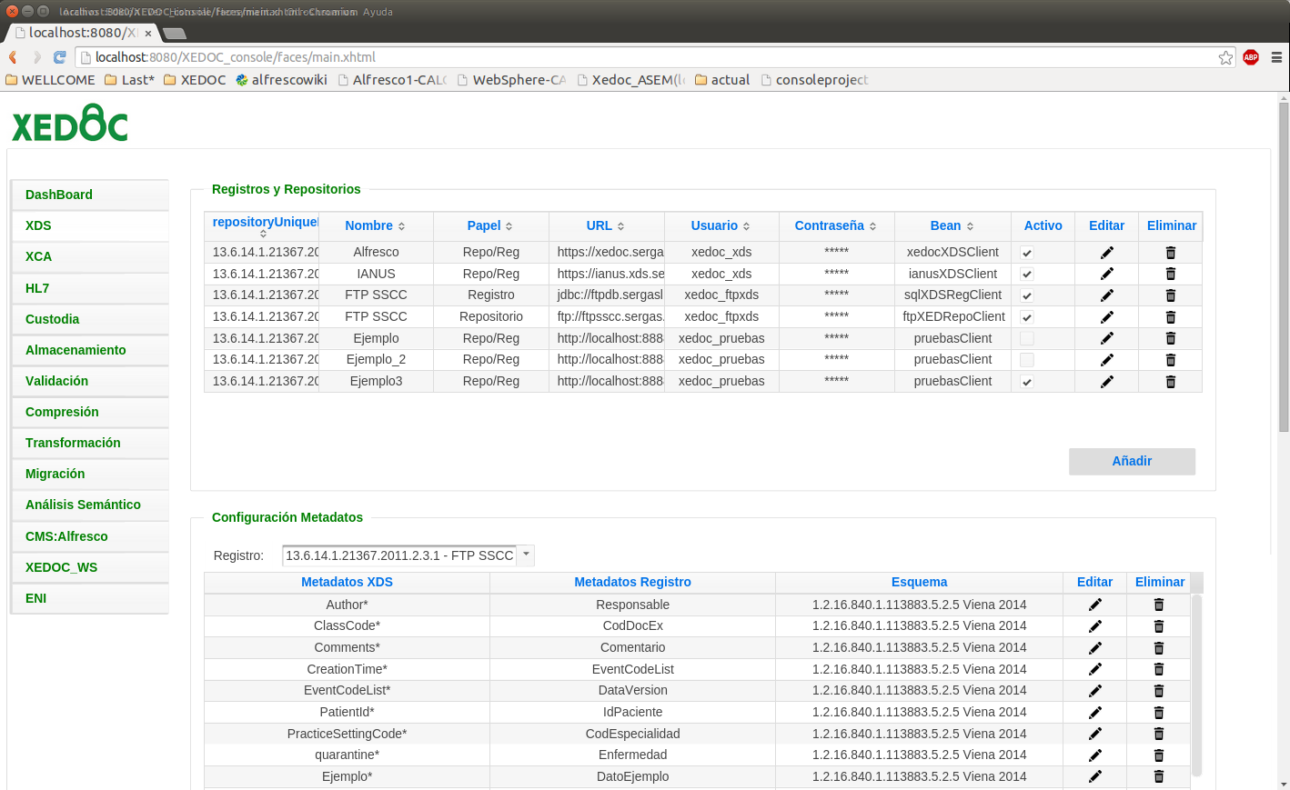
Interoperability Hub

Slide 27
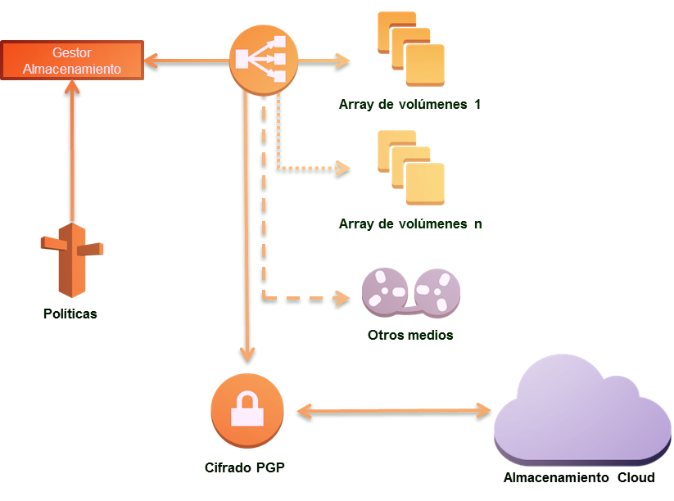
ILM
Volume Management:
Based on metadata
Based on available space
Closing volumes to optimice backup

Slide 28
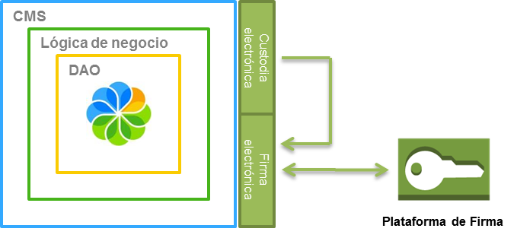
Custody
Promoting digital signature
Re-signing documents
Transformation to long-term access format
Signature platform integration

Slide 29
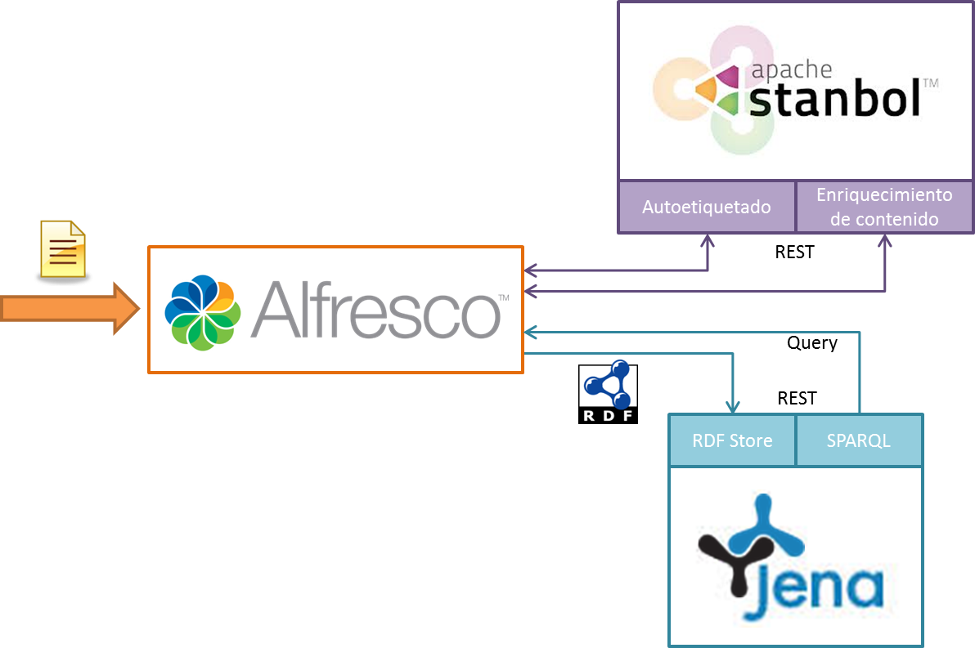
Semantic analysis
Semantic analysis using customizable ontologies
Content Auto-tagging
Content data enrichment
Semantic search

Slide 30
Semantic analysis
Sample of rich content

Slide 31



Migration tool with an API
Tools and services to migrate from current repositories
Multiple sources:
FTP, Filesystem, Database, etc …
Intelligent migration systems, that adapts itself depending on the
repository load
API Batch
Current repositories

Slide 32
Transformation Server
Digital Signature
When | and | and | Do/execute
{hc}docExt=true | {hc}codCentro=270095 | {hc}contentType=application/pdf | setFirma(“XAdES”)
{hc}docExt=true | {hc}appOrixe=“SEGES” | {hc}contentType=image/jpeg | setFirma(“XaDES_Detached”)
Long-term
When | and | and | Do/execute
{hc}docExt=true | mimeType=“img/png” | {hc}appOrixe=“SEGESDOC” | setTransformacion(“PDF/A”)
{hc}docExt=true | mimeType=“ms/word” | {hc}tipoDoc=“TD14” | setTransformacion(“PDF/A”)

Slide 33
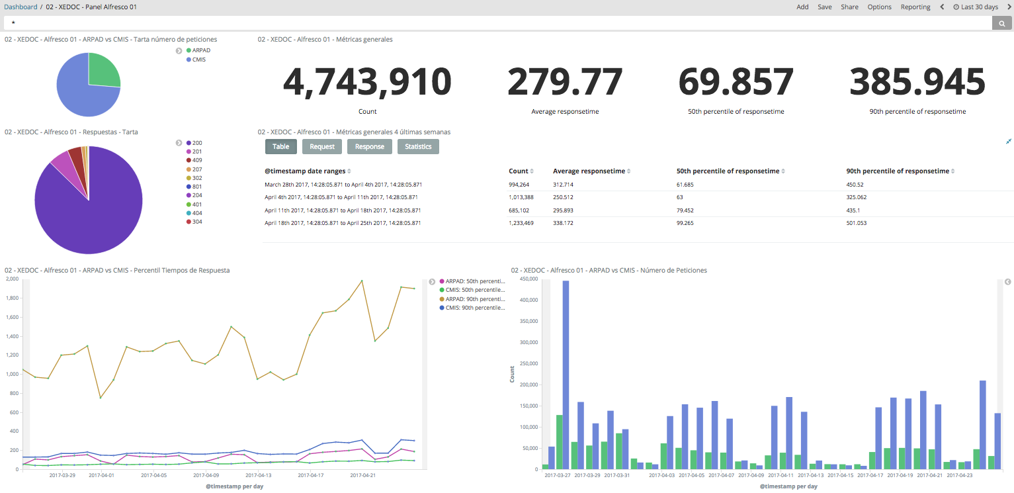
Monitoring Server
Access from another hospital, ER, etc …

Slide 34
Success Case

Slide 35



Sucess Case
Clinic History document management
Document Management system implementation
Digitization process creation
Duration of 4 years
Activities
Architectural definition
Modules development
Installation and configuration
Process definitions
Volume
20.000 documents/day (10 GB)
2.000 request/minute
15.000 users
Team
1 Consultant
1 Architect
2 Developers
1 Administrator
1 Support
Architecture
Four nodes in cluster
Alfresco 4.1.8

Slide 36
Success Case
Response times, in high load situation:
Search: 200 ms
Download documents: 1 s
Add documents: 2 s
High availability with 4 nodes x 4 cores (8 Gb)

Slide 37



Success Case
472
20k
18M

Slide 38
Victor Fariña
Victor.farina@queres.com
Twitter: @coffman

